Slide 1

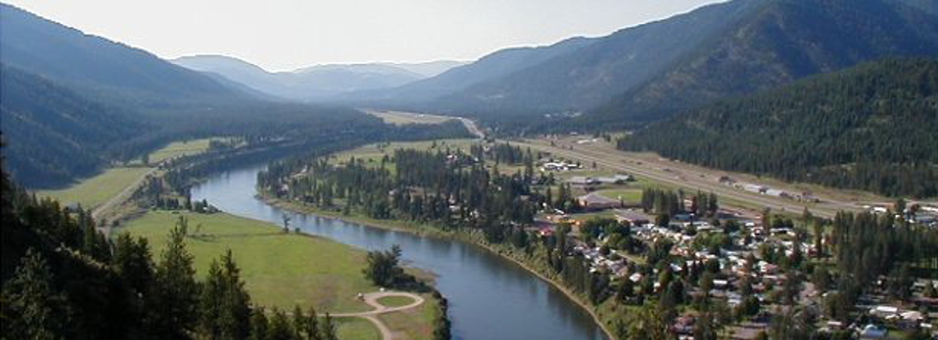
SUPERIOR SCHOOL DISTRICT
"EVERYONE WORKING TOGETHER FOR A SUPERIOR EDUCATION!"
PO Box 400, Superior, MT 59872
Phone 406-822-3600 | Fax Elementary: 406-822-3601 High School: 406-822-4396
Notes:
Hello, my name is Beth Keyser. I teach English to grades 7-12 in Superior, MT, a tiny rural town of under 900 people, which is the County seat of Mineral County. Several Native American tribes including the Salish Kootenai, Pend d’Oreille, and Nez Perce traveled east along the Clark Fork River to hunt buffalo.

Slide 2
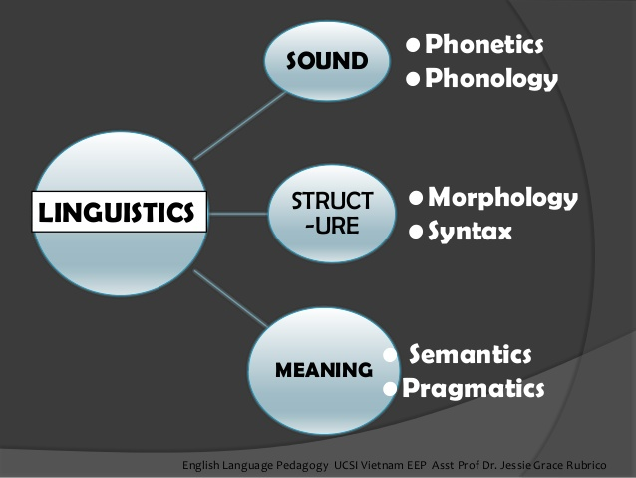
Notes:
My approach to linguistics has been creating units within my English classes. I focus on syntax, morphology, phonology, and semantics in my seventh grade class. We begin by understanding parts-of-speech, so when I teach students syntax trees, we have a common vocabulary with which to work.

Slide 3
Syntax
Notes:
Syntax has always fascinated me. As a matter of fact, when I was in college, I took a graduate level syntax course, which helped me understand why I was making mistakes in writing. I also became very curious about language in general and began doing more research on the subject, mostly through long interviews with my father.

Slide 4
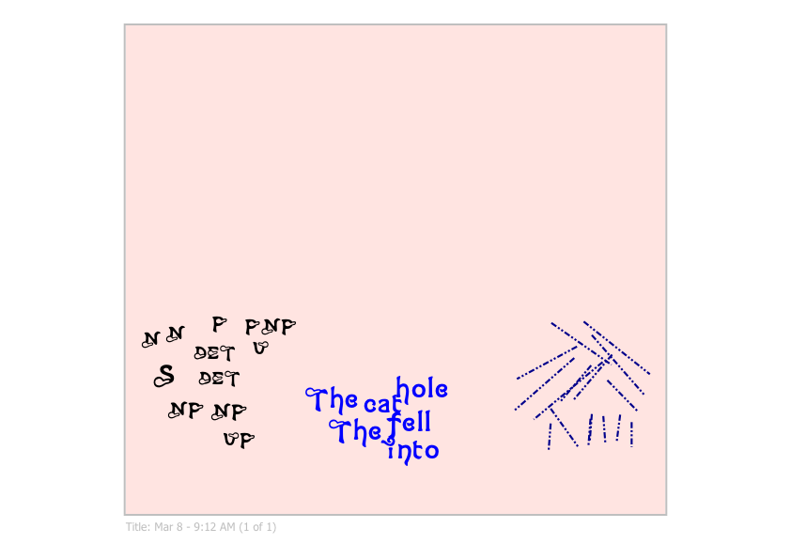
Syntax Unit
Students see that sentences are more than a string of words.
Students put this sentence together as a class.
Notes:
I begin the syntax portion of my linguistics unit by scrambling words. I ask the students to put them in a sentence on a piece of paper. Every student in the class does this without error. I then ask them how they managed to do that without the help of anyone. This is the way in which I reveal the idea that sentences are not just a string of words.

Slide 5
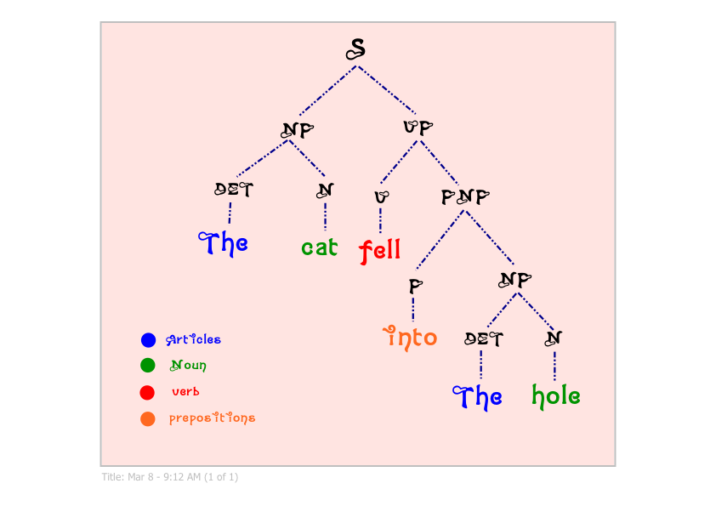
Syntax Lesson
Add color coding for final tree
Practice
Notes:
I work through the process of building a tree with students, give them some practical tools to help them differentiate among the parts of speech, and teach them how sentences can be represented in a tree. They practice making trees with different types of sentences. This allows me to start talking about the relationships phrases have with each other.

Slide 6
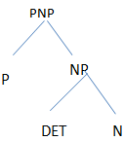

S
VP
NP
V
NP
in
DET
N
N
drank
coffee
morning
the
grandmother
the
Notes:
One of those relationships is sentence adverbials. I wanted my students to see that some phrases can move around the sentence. Here is a slide I created to help students understand it. They read the phrase along with the monkey. I playfully call them “swinging monkeys”. I even provide sound effects, which are not present here.

Slide 7

S
NP
VP
N
VP
PNP
Sally
V
P
NP
sunbathed
by
Det
N
the
stream
Sally sunbathed by the stream.
Notes:
After students understand how to build trees, I want them to begin to understand how phrases interact with each other. I usually focus on verb groups. I want students to see the difference among transitive, intransitive, ditransitive, and intensive verbs. I even give them a lesson on particles. That’s as far as I have gone with this unit.

Slide 8
S
S
Adv.
NP
VP
P
NP
V
NP
I
with
Pro
N
ate
N
N
CC
gravy
my
family
turkey
and
I ate turkey and gravy with my family.
Notes:
I also teach them how to tree compound sentences and compound noun phrases. Now that students understand how syntax trees work, I can use them when I talk about how to write and punctuate these types of sentences. The different uses of coordinating conjunctions in sentences all of a sudden make sense when they are treed.

Slide 9
Morphology
Notes:
While we build our vocabulary for parts of speech, nouns, verbs, adverbs, adjectives, pronouns, prepositions, and determiners, I approach the lessons inductively, so students have to figure out the parts of speech and how they work in sentences. I give them tests as well to identify parts of speech.

Slide 10
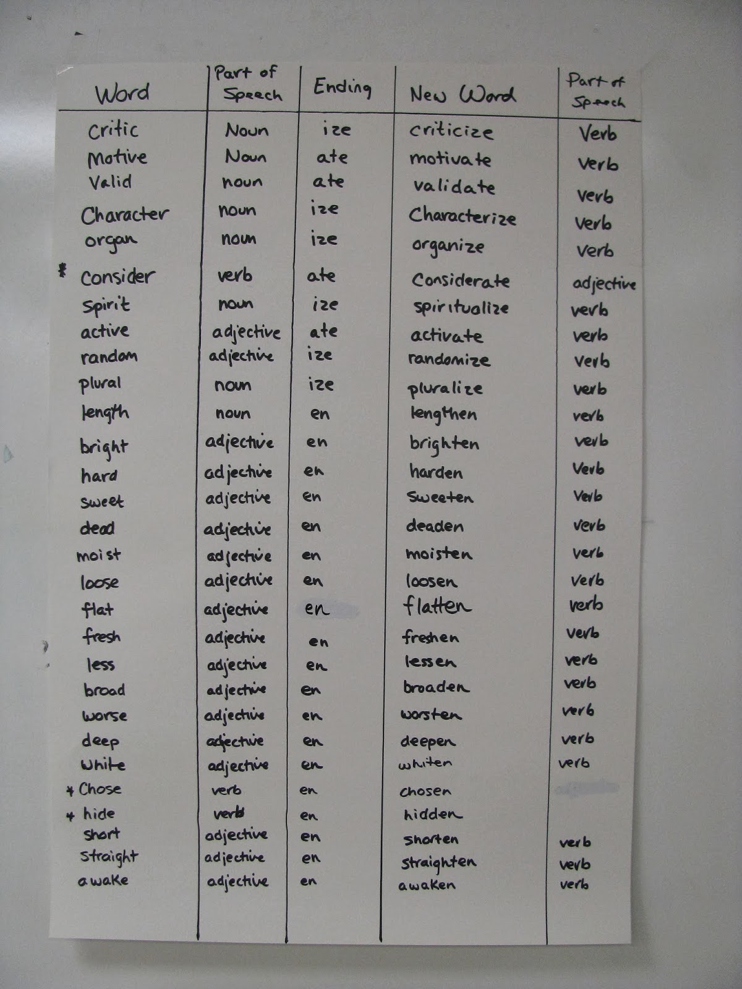
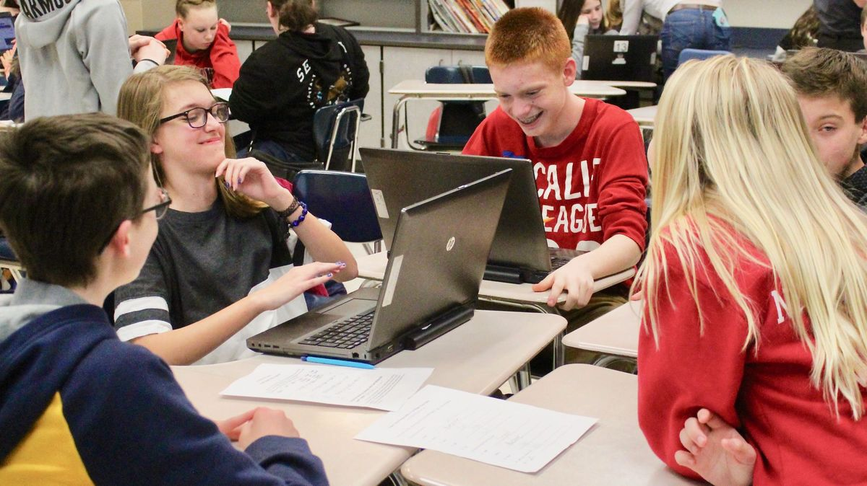
Middleschoolling.blogspot.com
Kristen Denham
Word | Part of Speech | Ending | New Word | Part of Speech
Consider | verb | ate | considerate | adjective
Notes:
I retrieved a lesson from Kristen Denham’s blog, about morphemes. My students discovered some inconsistencies in the way words and their suffixes change parts of speech. In this case, the suffix ”ate” sometimes changed words to adjectives and sometimes to verbs. We sent our poster to her, which she posted with an explanation for the discovery.

Slide 11
Phonology
Notes:
I use phonology as a way to help students understand that they need to be observers of what they hear as well as what they see on the written page. I use poetry as the means by which to teach this since poetry lends itself to oral reading because it is full of both beautiful rhyme and meter.

Slide 12
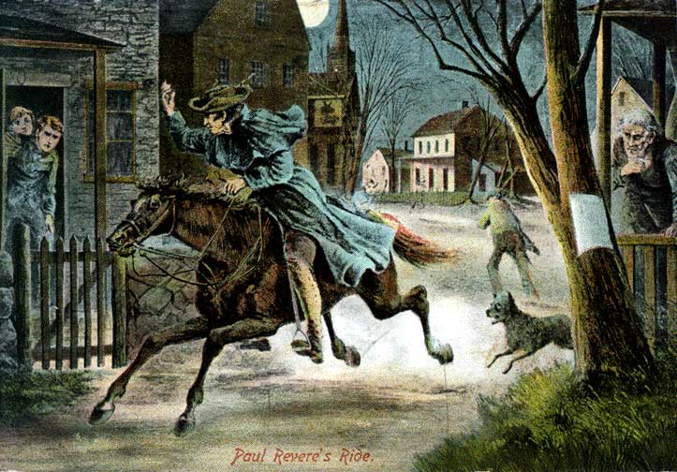
Notes:
In poetry, I talk to my seventh grade students about stressed and unstressed syllables so they can figure out the approximate meter of Paul Revere’s ride. It turns out, in my class anyway, that not all the students automatically figure out what syllable is stressed and which is not. This takes a lot of practice in some cases. I have also noticed anecdotally that students with speech issues have a harder time with this task.

Slide 13
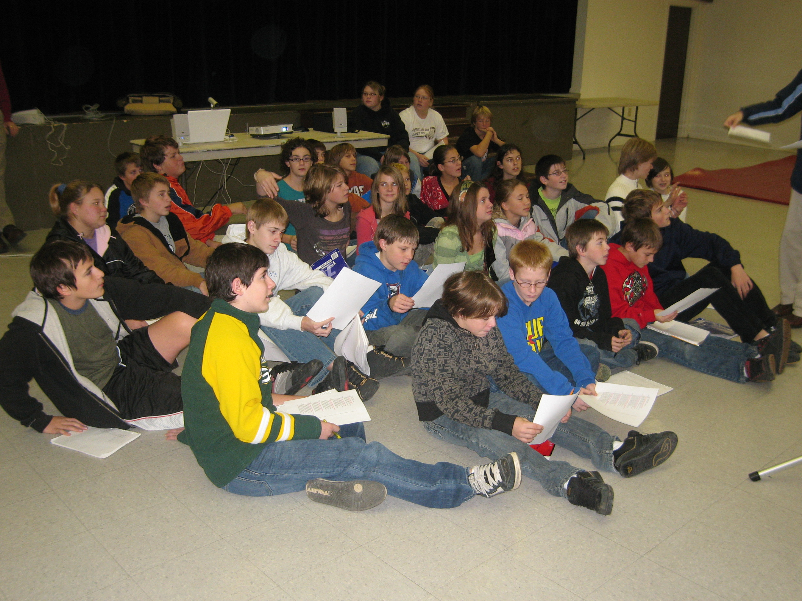
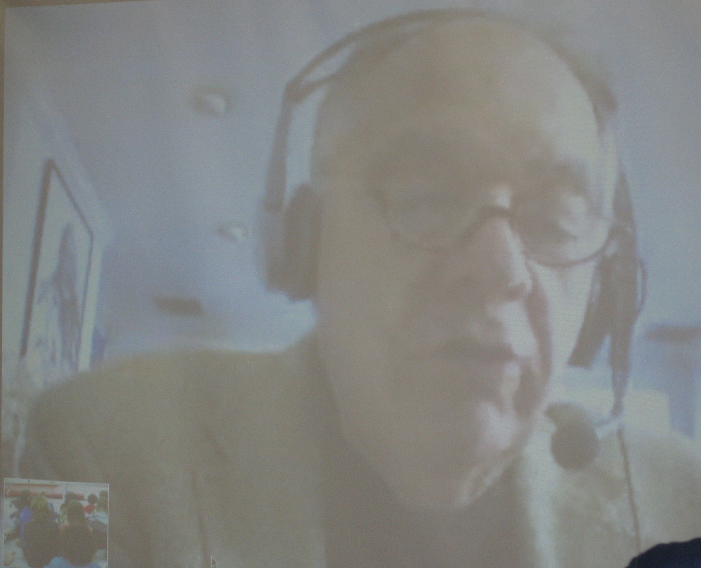
Students in Superior, MT
Linguist in Cambridge, MA
Notes:
My father, a linguist who specializes in phonology, and I have been working on ways to teach stress in multisyllabic words because this helps students understand how meter is tracked. Phonology discussions in my AP English Literature classes have been particularly good because they deepen my students’ understanding of what makes poetry such a unique genre and what makes language so exciting.

Slide 14
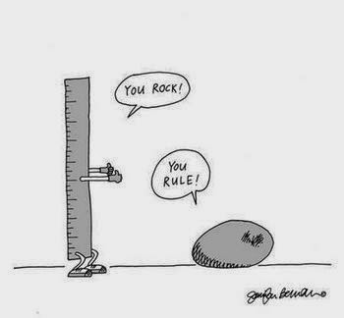
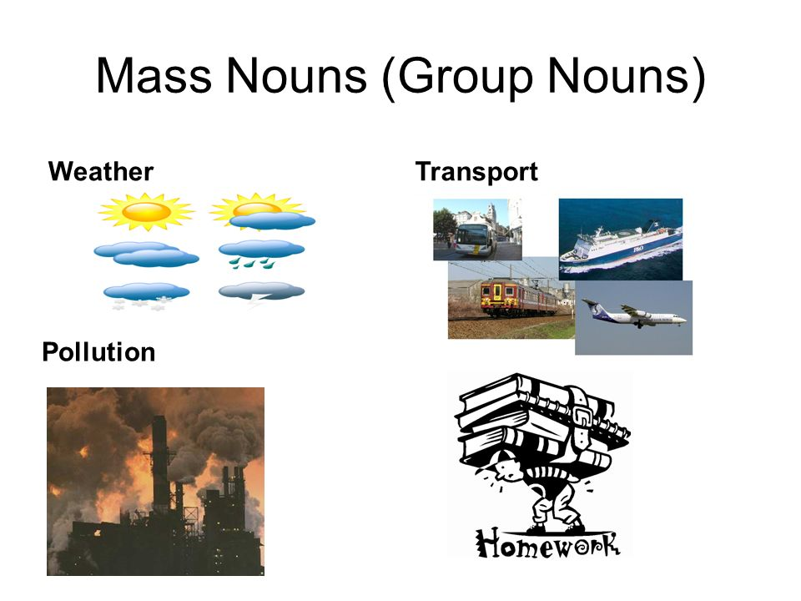
Semantics
Notes:
I am often reminded of exceptions in English grammar. Therefore, I look for ways to help students see its unpredictability. For example, instead of giving students a general and inadequate rule about nouns, I give students a list of count nouns and mass nouns and ask them to figure out difference.

Slide 15


Problems
Notes:
I run into several problems while teaching linguistics. One is that I don’t have many answers to questions without having to do research. I also find that among my linguist colleagues, there are sometimes divergent answers to my questions. Linguistics gets deep quickly, and I often find myself scratching my head…. Finally, I need more time to incorporate linguistics into my already packed curriculum.

Slide 16

Solutions
Middleschoolling.blogspot.com
Kristen Denham
Teach Ling
https://teachling.wwu.edu/
Notes:
I have benefited from having a linguist in the family, so I can get help anytime I need. I have also benefited from working with other linguists, who are interested in bringing linguistics into middle and secondary school. The list is long, but Kristin Denham and Anne Lobeck have offered workshops and developed websites with lesson plans.

Slide 17

Notes:
Finding ways to bring linguistics into junior high and high school has been a joy for me for years, therefore, I am excited that using AP as a way to incorporate linguistics into high schools across the nation, and I am hopeful it will have a far reaching and profound affect on student learning k-16.

Slide 18
REFERENCE PAGE
ATKIELSKI, JACQUI (2017)
http://www.somdnews.com/enterprise/spotlight/st-mary-s-teacher-helps-students-with-stock-market/article_7fd5cccc-3616-58b1-8359-4188a6f85c3b.html
Denham, Kristen (2008). http://middleschoolling.blogspot.com/
Fredette, Jen. http://mineralmthistory.com/?page_id=27&theme=1
Haikudeck (2015).https://www.haikudeck.com/mass-nouns-and-count-nouns-education-presentation-7LHhyJEC5J
K-12 Teaching and Learning Platforms (2015).http://institute-of-progressive-education-and-learning.org/k-12-education-part-ii/based-learning/
Mr. Dowo Portal. http://www.mrdowoportal.com/morphology.html
Paul Revere’s Ride. http://www.historycentral.com/Revolt/nimages/revere.jpg
Phonology:https://ellinfobcps.weebly.com/phonology.html
The meme merchant (2013)http://mememerchant.blogspot.com/2014/10/semantics.html
Traditional Linguistics Syntax Tree. http://specgram.com/CLIII.d/02.nattapong.diagram.html

